Slide 1
Application for International Students
Vorbereitungsstudium (VBS) - Preparatory studies
Stand 09/2021

Slide 2
Welcome!
This is a step-by-step application guide for international students who have a direct entrance qualification but no C1 German yet and need to enrol in the preparatory course.
Before you continue you should have:
Opened the MOIN-Portal (https://moin.uni-bremen.de)
Registered and received a confirmation email with a password (which can be changed after your first log-in)
Scans of all documents such as diplomas, transcripts and/or certificates ready

Slide 3
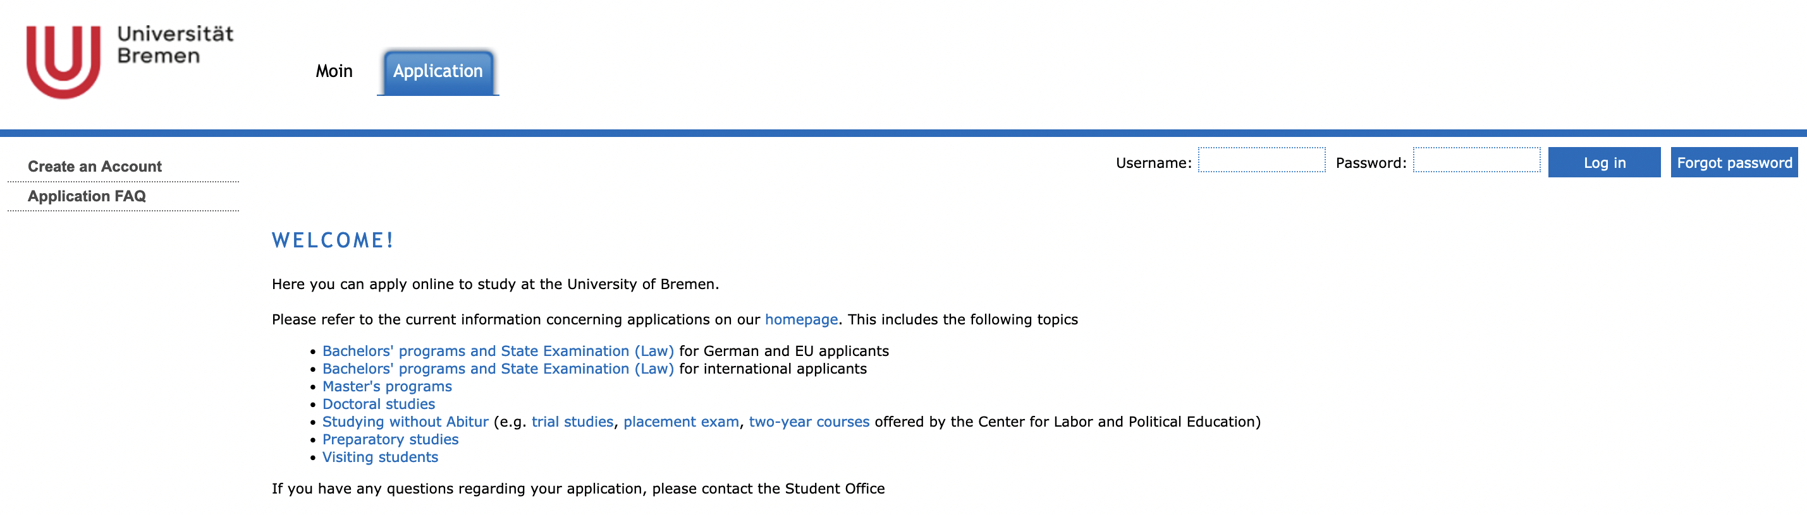
Log In
This is the homepage of the MOIN Portal. Note that there are two log in options: „Moin“ and „Application“. It is important that you log in at the „Application“ website.
If you do not have an account yet, you can create a new account here. Before you can log in and start your application you will receive a confirmation mail. This might take an hour or two.

Slide 4
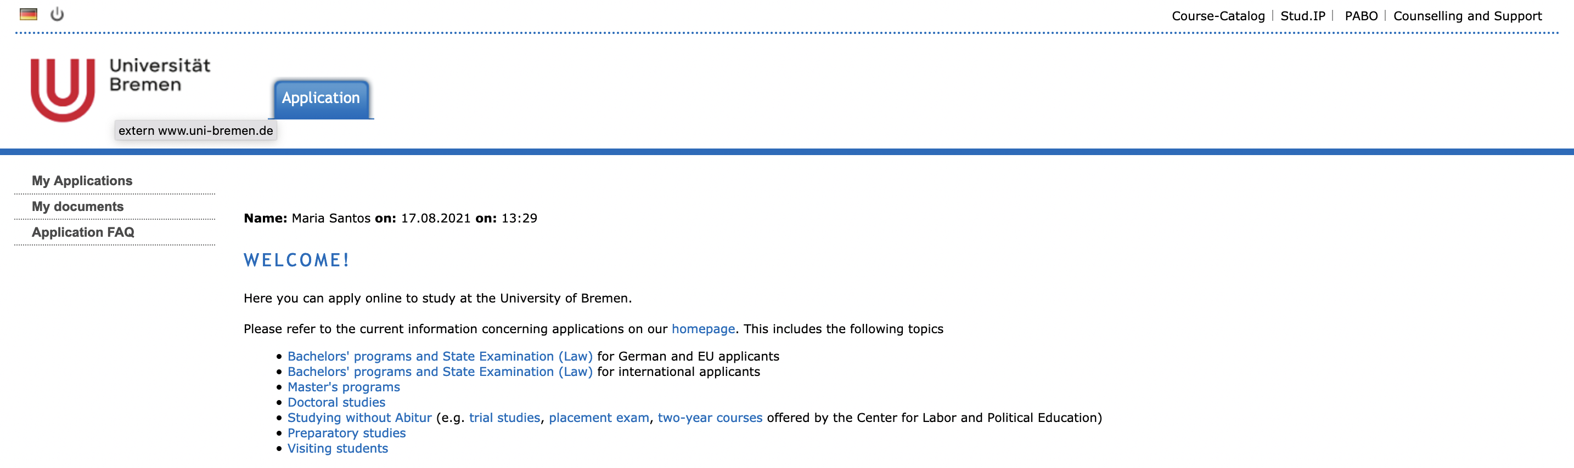
Choosing your type of study
In this example, the person wants to apply for the preparatory studies. You can find more information on the course by clicking on “Preparatory studies”. You can start the application by clicking on „My Applications“ in the left column.

Slide 5
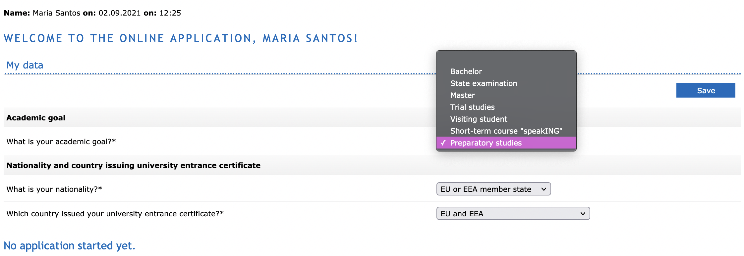
Here, you should choose the preparatory studies.

Slide 6
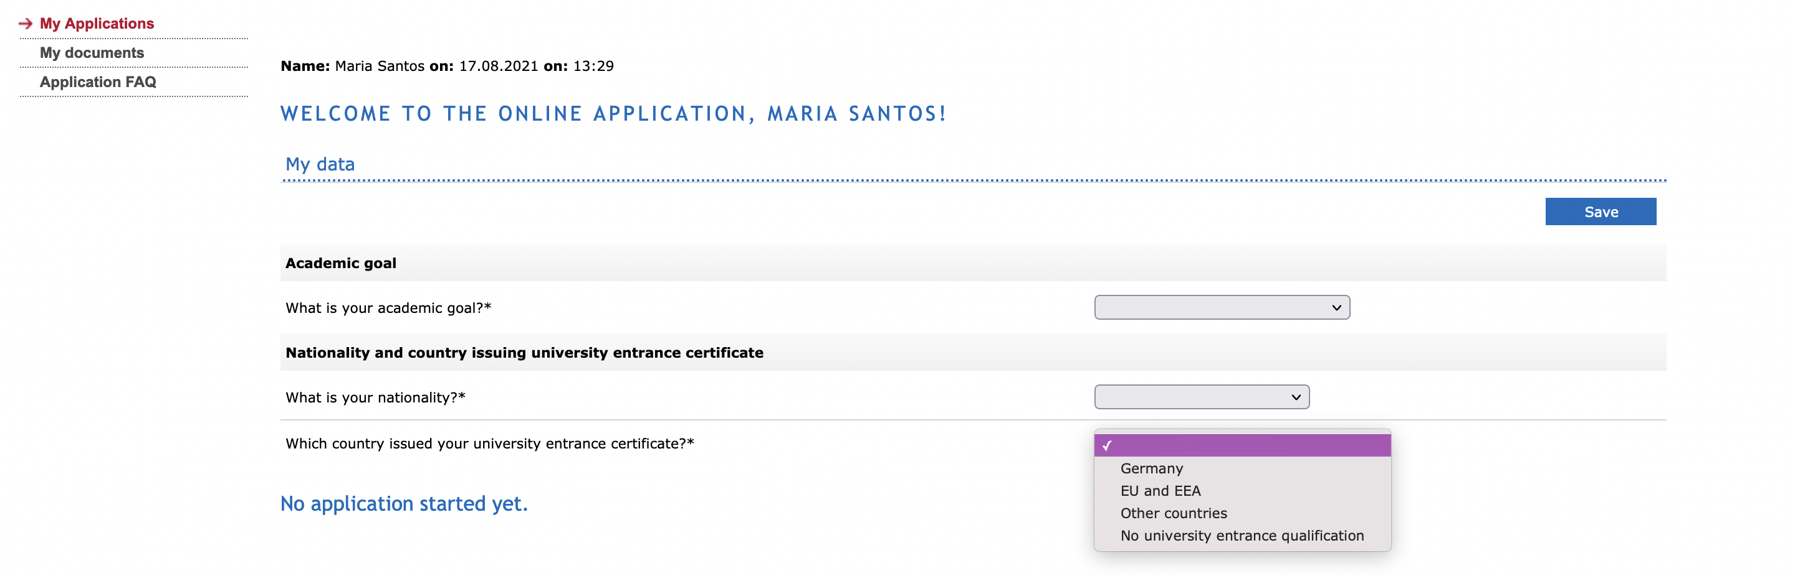
Here, you choose your nationality, as it is important for the recognition of your university entrance certificate.
Bachelor:
EU and EEA citizen can directly apply at MOIN
Other countries need to receive a “VPD (Vorprüfungsdokumentation)” from uni-assist in order to apply. The VPD counts as your university entrance certificate.

Slide 7
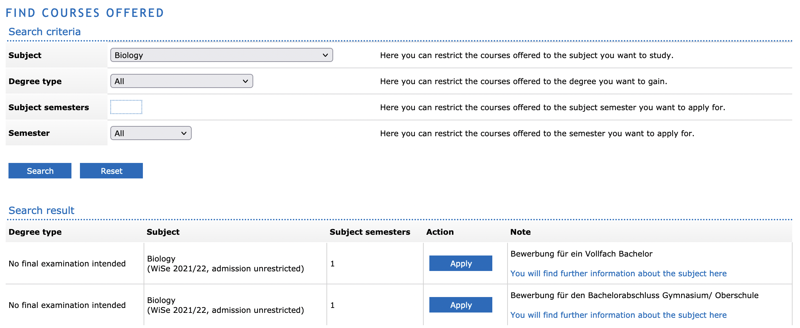
You can find the course you want to study after finishing the prep course by choosing various criteria to refine your search. By clicking on “Apply” you will be forwarded to the application process for the specific course. You can apply for one course only! Students enrolled in the prep course are not allowed to take exams. After reaching C1 in German you will have to undertake the regular application process for BA courses, the course can be changed.

Slide 8
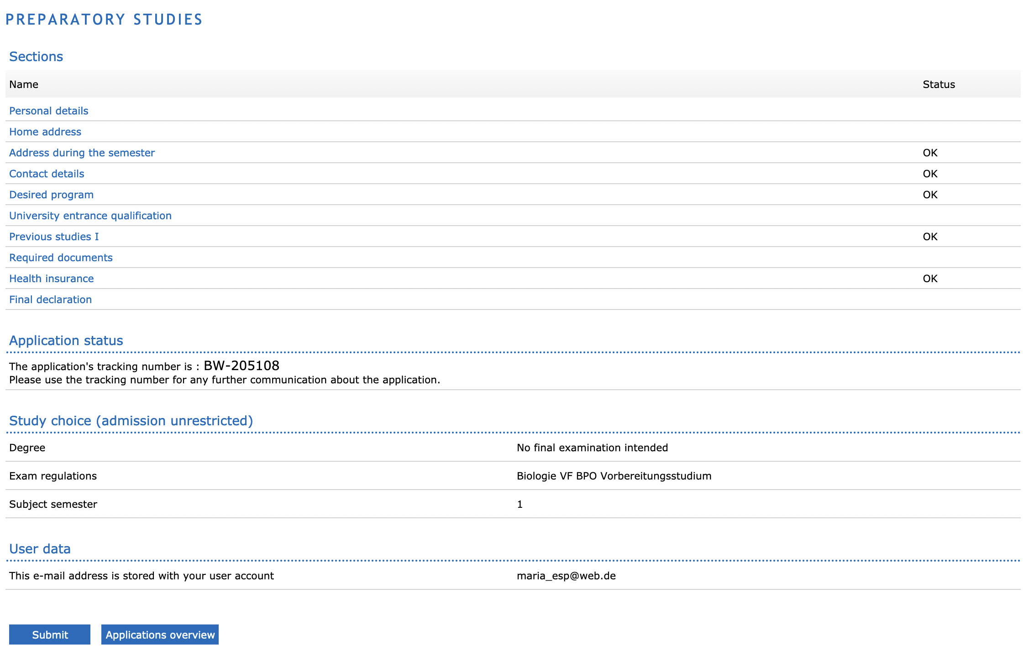
This overview with different sections will appear after you have clicked on “Apply”. An “OK” as status means that everything is filled out in this section. However, you should always go back and double-check everything. The next slides will go over all sections from first to last.

Slide 9
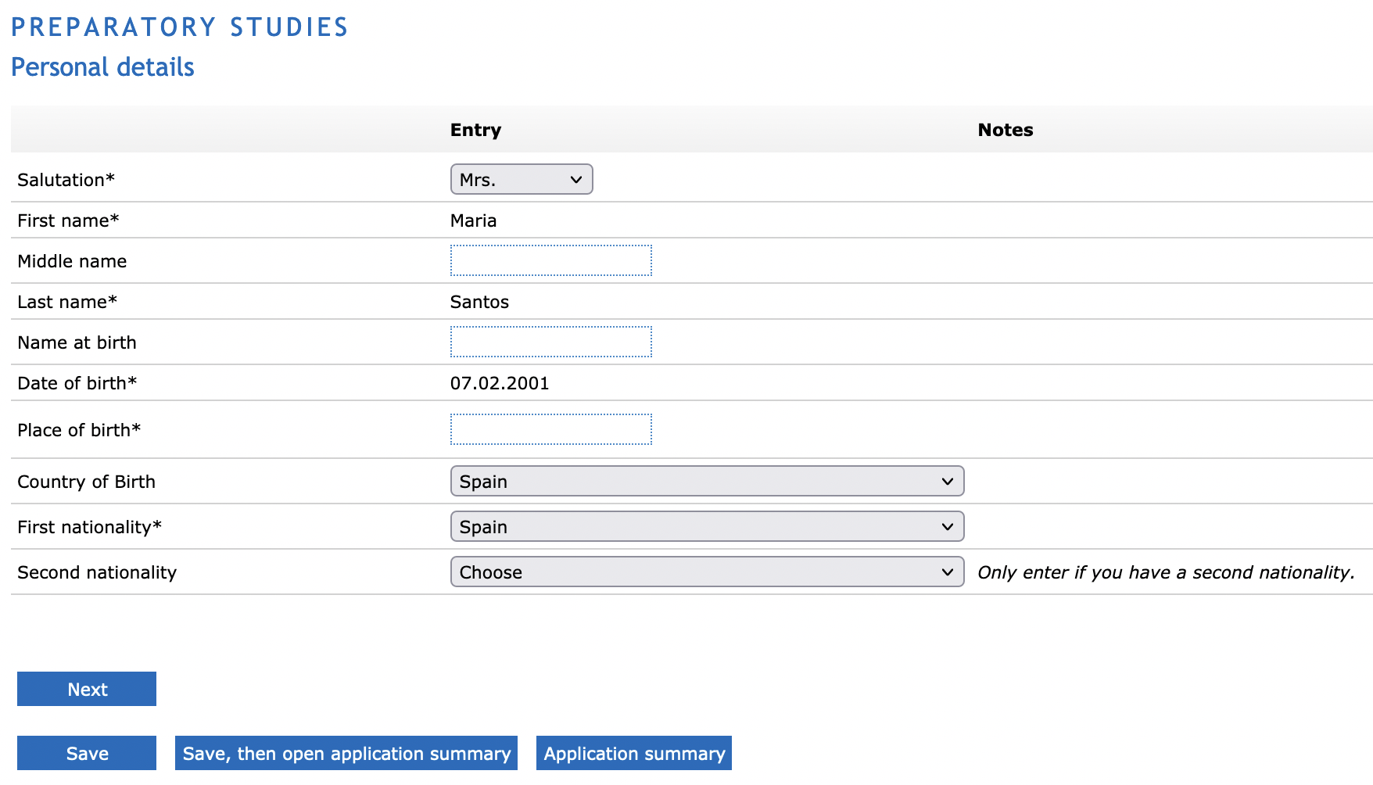
Personal data
All boxes with a * are mandatory. “Name at birth” must only be filled out when you have changed your name in the past.

Slide 10
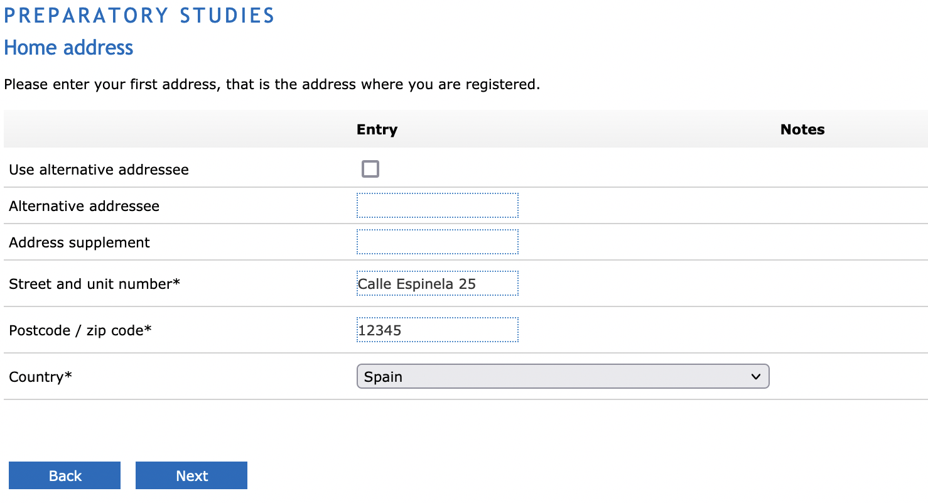
Home address
This is your home address, e.g. your parent’s address or your address at the time of the application.
The next option/slide will be your ”Semester address”, meaning the address that you have during the semester.

Slide 11
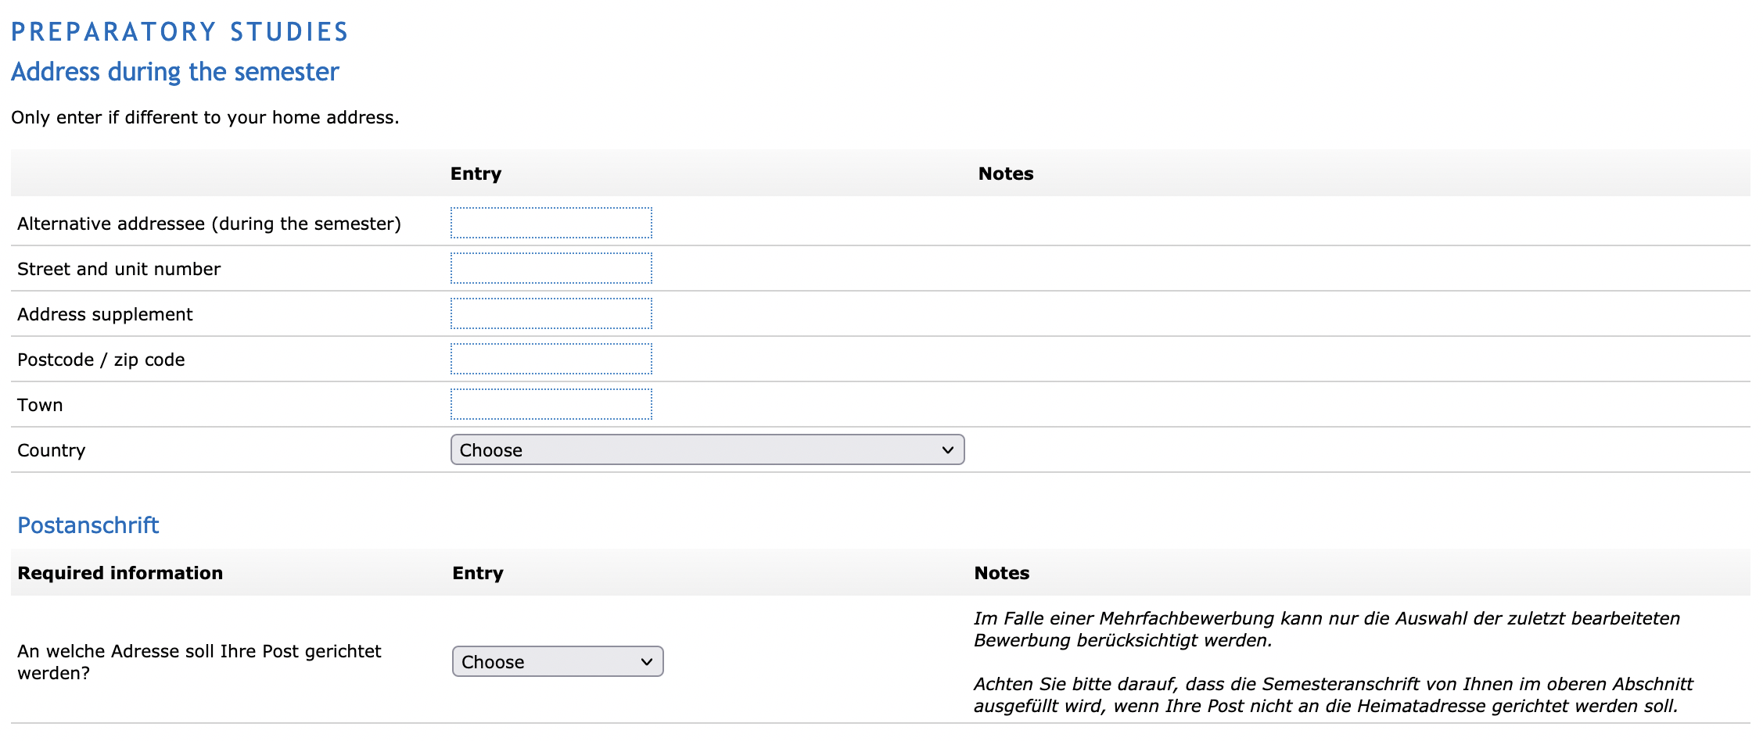
Semester address
Usually this is your address in Bremen. If you don’t have a postal address in Germany yet, you can leave this blank. Your student ID and other important documents are sent to the address that you choose under “Postanschrift”. You can always change the address afterwards.

Slide 12
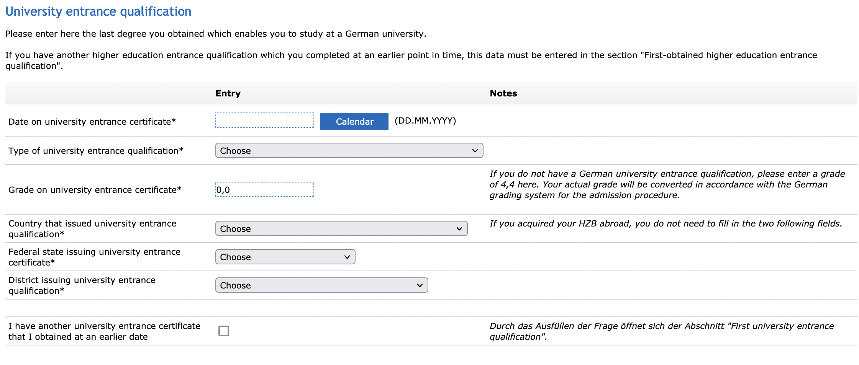
University entrance qualification
For all applications you need to give information on your university entrance qualification (UEQ). For non-EU certificates this is the VPD from uni-assist. The date of your UEQ can be found on your certificate/diploma.

Slide 13
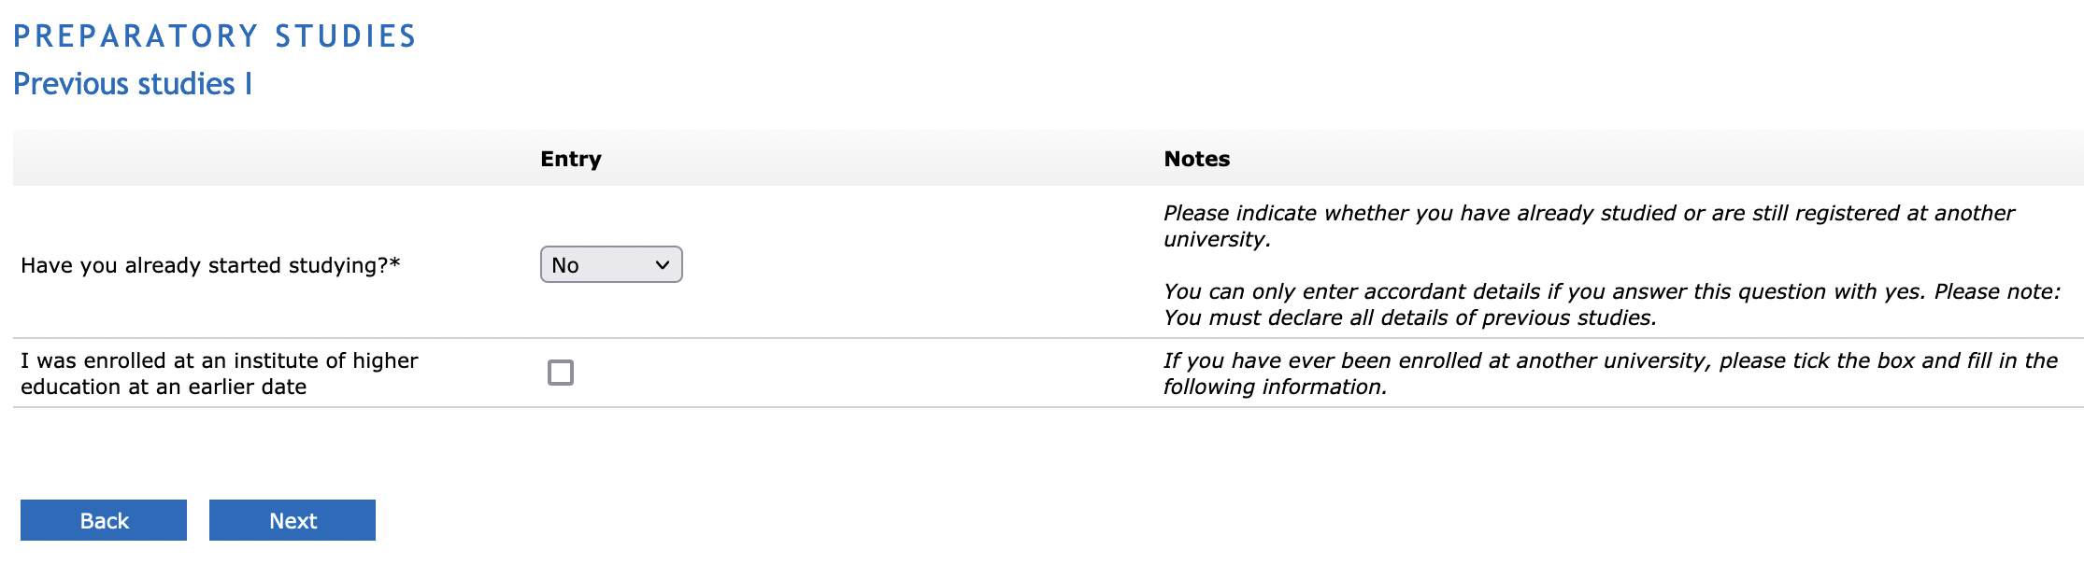
Previous studies I
If you have already started studying at another institution you must mention it here.

Slide 14
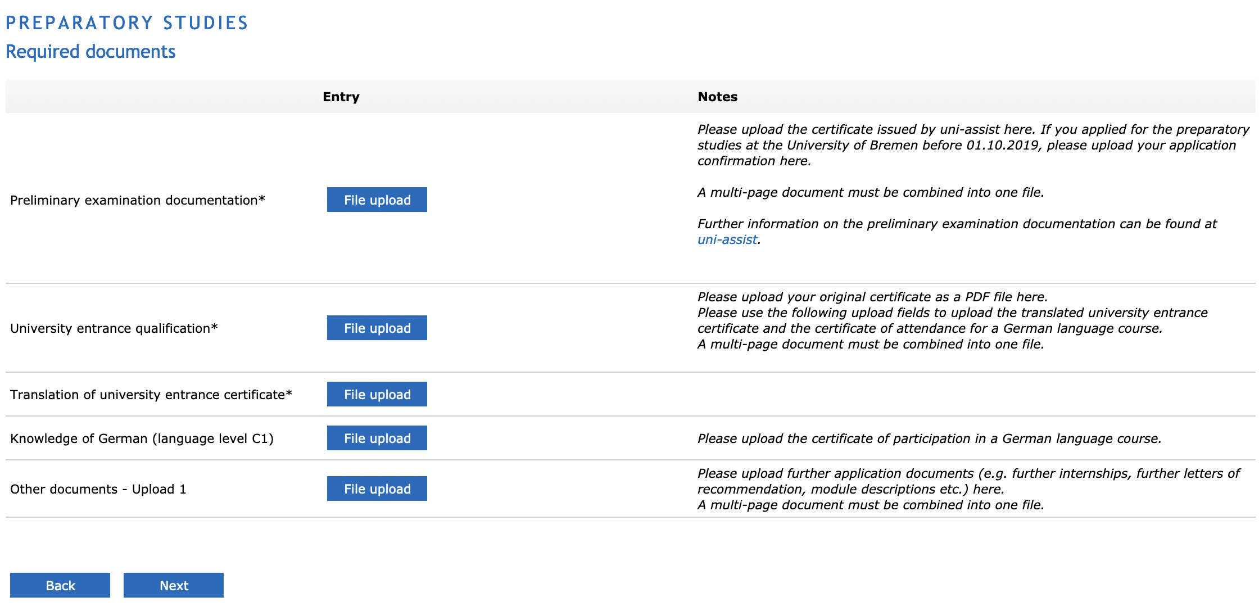
Required documents
Based on the program you are applying to different documents are needed here. Documents with a * are mandatory.

Slide 15
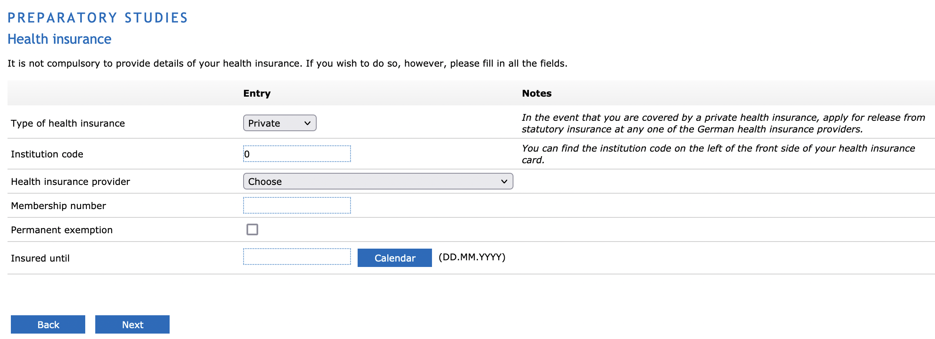
Health insurance
In Germany health insurance is mandatory. There are numerous private and statutory health insurance providers you can choose from. In case you have not arranged a health insurance yet you can leave this open. By the time of your enrollment you need to show proof of your health insurance.

Slide 16
Finalization of the application
When your status shows „OK“ in every section you must submit your application. Even though you have already clicked on „Apply“ to start the application process, it is important that you submit it when everything is filled out!
It is recommended to double-check everything before submitting, as this eases the processing of the application for both sides.
If there are any unclarities or questions during the process of application you can always contact the „Sekretariat für Studierende“ (SfS, sfs@uni-bremen.de).
Best of luck on your application!

Slide 17
What happens now?
After submitting your application the SfS will send you an email that confirms your submission.
The SfS checks your application and contacts you if there are further queries or missing documents.
The SfS will inform you about your acceptance. You will receive a „Bewerberbestätigung“ (BBZ).
With the BBZ you can then apply for your visa.
The SfS needs proof of the intensive language course (at least 20h/week for a minimum of three months) as well as the BBZ in order to send you your enrollment documents
The semester fee must be paid in order to finalise the enrollment.

